Slide 1
Medical Social Network
By: Andrew Smith, Kyle Busch, Michaela Lightner, James Tomasko

Slide 2
Goal of the Application
Connect clinicians and patients
Provide an easy way to create an account
Friend system between clinicians and patients
Patients can post about relevant information
Clinicians are able to respond to posts

Slide 3
Features of the Website
Simple, easy to use interface
Made up of three main pages
Account information can be updated at any time
Comprehensive patient information
Medical history, contact info, other details
Friend system is used to connect clinician and patient
Able to search for a specific clinician and friend them
Friended clinicians can view the patient’s posts

Slide 4
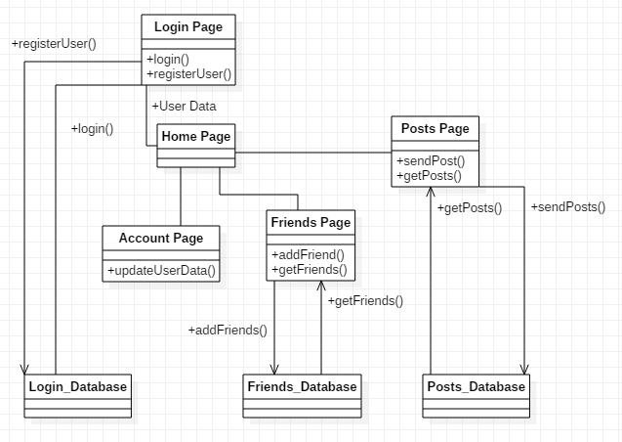
UML Structure

Slide 5
Design Choices
Requires clinician ID to create a clinician account
Avoids fraudulent clinician accounts
Provides a way to verify qualifications
Consists of three main pages
Home page for posts
Account page for updating information
Friends page for friending clinicians

Slide 6
Quality Assurance and Testing
PHPUnit used for unit tests
Selenium used for automated website tests
Manual testing used for smaller issues
Used Backlog as our bug tracker
Several user tests were conducted

Slide 7
Demo
http://esofmsn.a2hosted.com

